Slide 1


Game Performace Web Application
PC Upgrade Advisor
By TaeJhan Albertson and Nathan Montoute

Slide 2
Agenda
Introduction
Problem Statement
Objectives
Existing Systems vs Our System
Technologies Used
Development Methodology
Database Design
Main Features
Security Features
Challenges and Solutions
Live Demonstration
Future Improvements
Conclusion
Questions

Slide 3
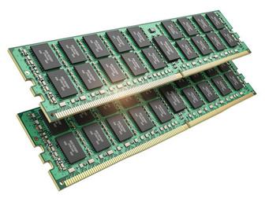
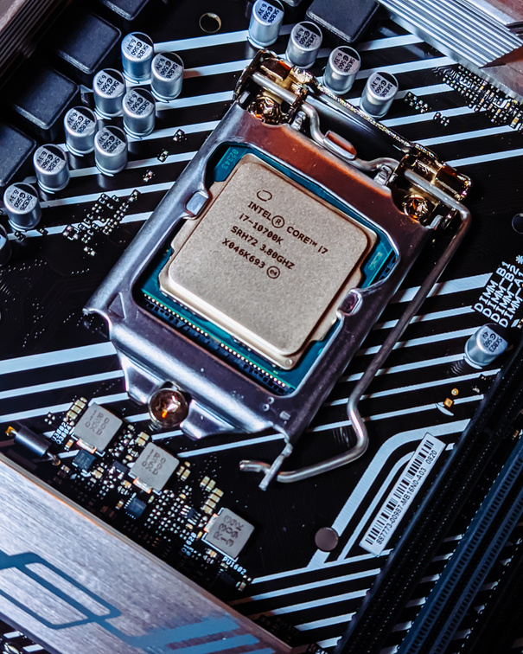
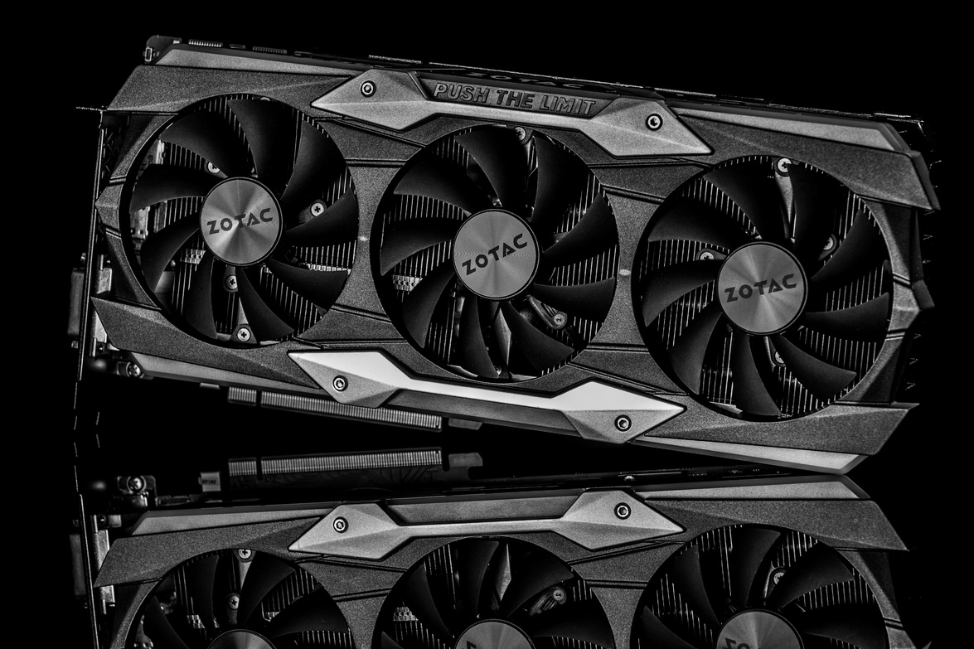
Introduction
PC gaming is becoming more popular
Many users do not understand gaming hardware
CPU, GPU and RAM affect performance
Users may overspend or buy weak hardware
Our system simplifies gaming performance analysis

Slide 4


Problem Statement
Many PC users struggle to understand hardware performance
CPU, GPU and RAM are difficult to compare
Existing tools only show requirements or benchmarks
Users make poor upgrade decisions
This leads to wasted money and poor performance

Slide 5



Objectives
Allow users to input hardware specifications
Compare hardware with game requirements
Analyze gaming performance
Detect system bottlenecks
Provide upgrade recommendations
Improve user decision-making

Slide 6



Existing Systems vs Our System
Existing Systems
UserBenchmark — benchmarking
PCPartPicker — PC building
Can You RUN It — game requirements
Our System
Combines benchmarks + game requirements
Provides personalized analysis
Gives upgrade recommendations
Beginner-friendly interface

Slide 7




Technologies Used
Frontend
HTML - Page Structure
CSS - Styling
JavaScript - Interactivity
Backend
PHP - Backend Processing
Database
MySQL - Database Storage
Development Environment
XAMPP - Local Server
HTML
CSS
JavaScript
PHP
My
SQL
XAMPP

Slide 8
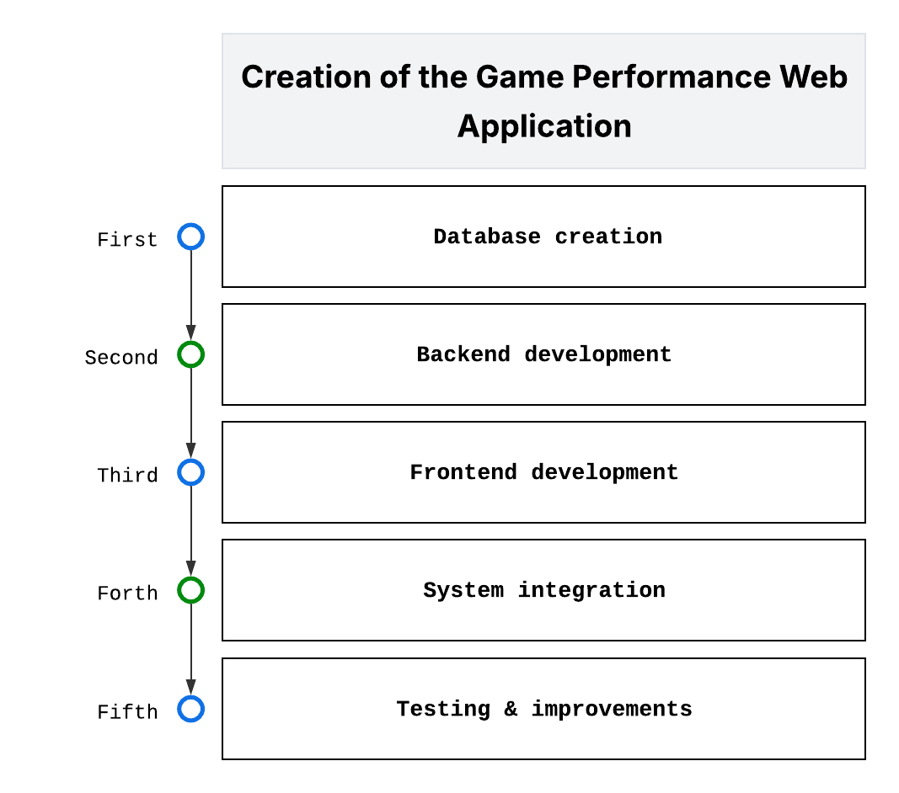
Development Methodology

Slide 9
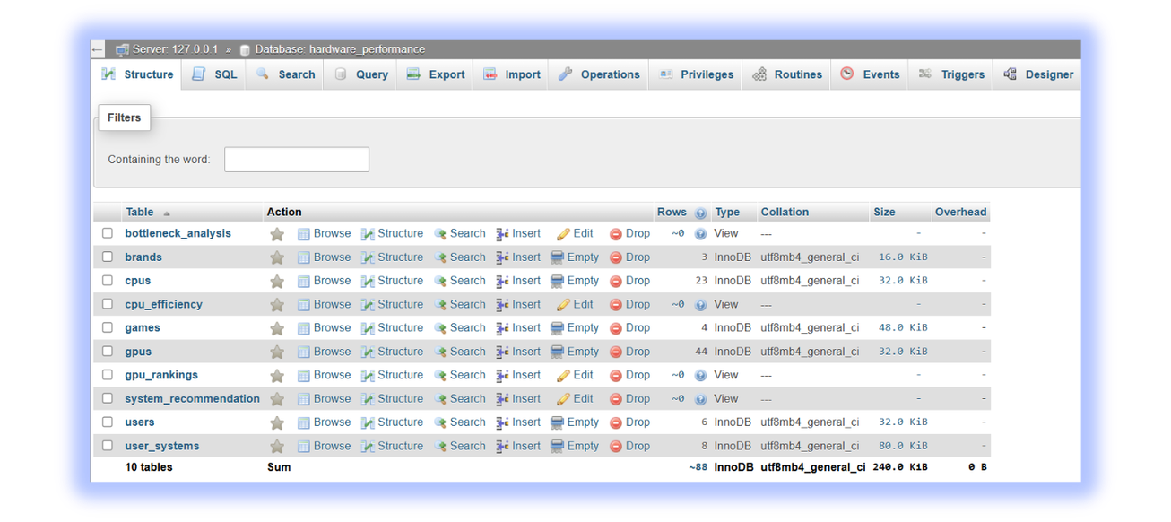

Database Design
The database stores:
User information
Hardware data
Benchmark scores
Saved system configurations

Slide 10
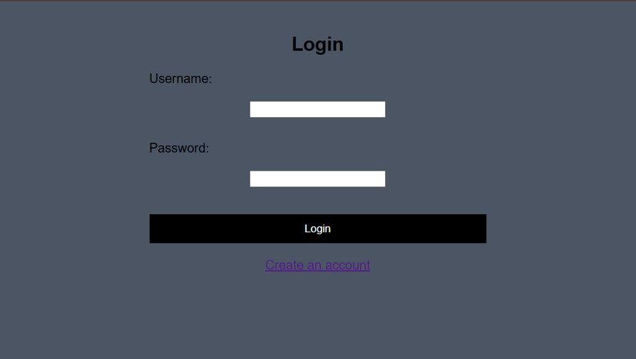
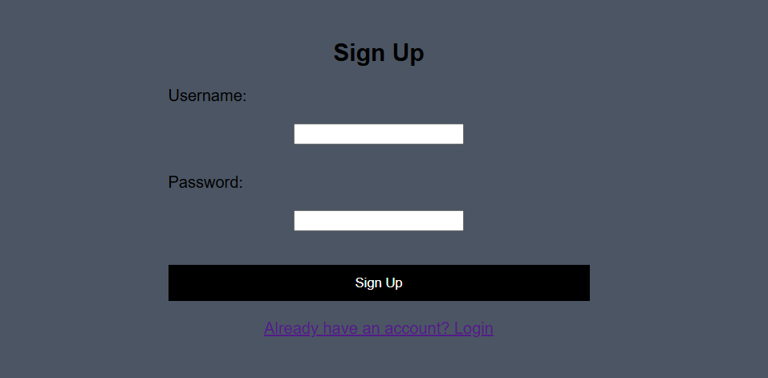
Main Features
🔐User Login & Signup Pages

Slide 11
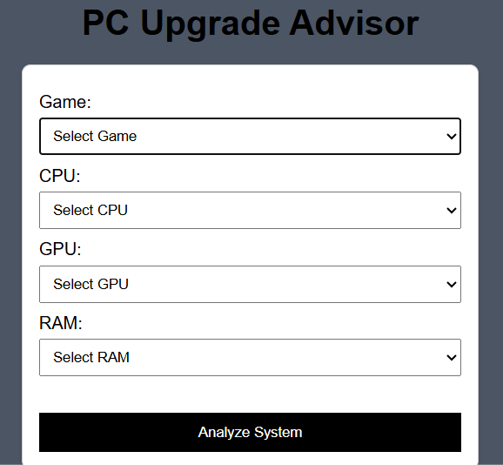
Main Features
👤User Selection Page

Slide 12
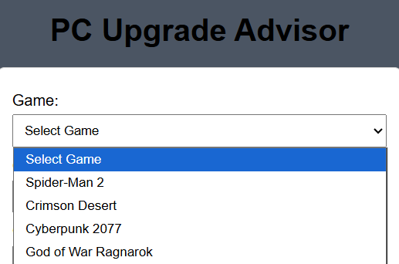
Main Features
🎮Game Selection

Slide 13
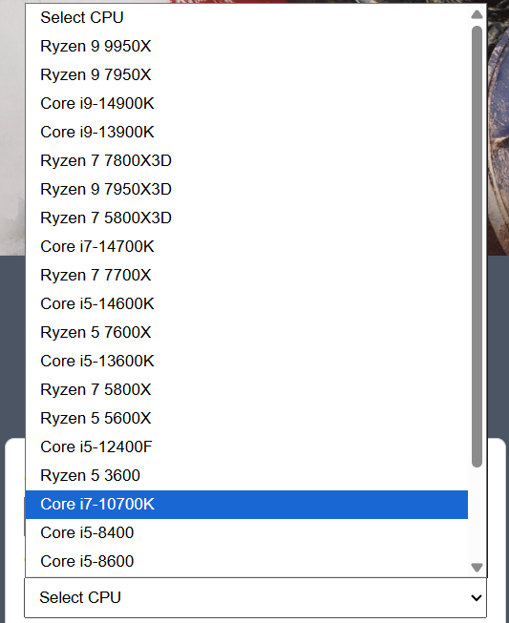
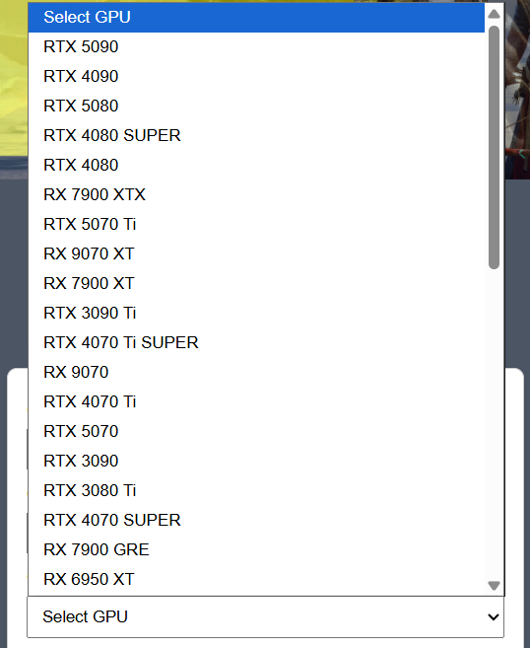
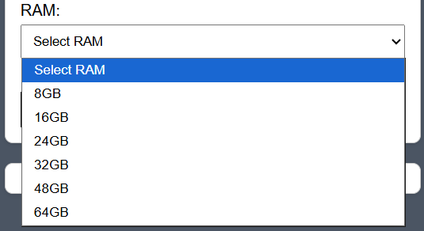
Main Features
🖥️Hardware Selection
CPU
GPU
RAM

Slide 14
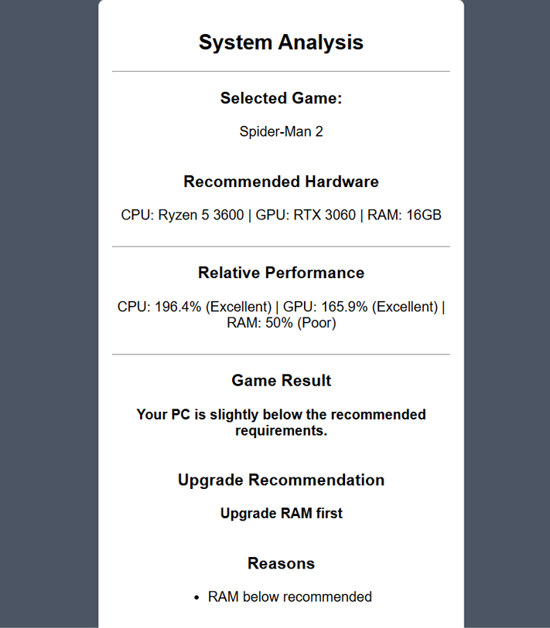
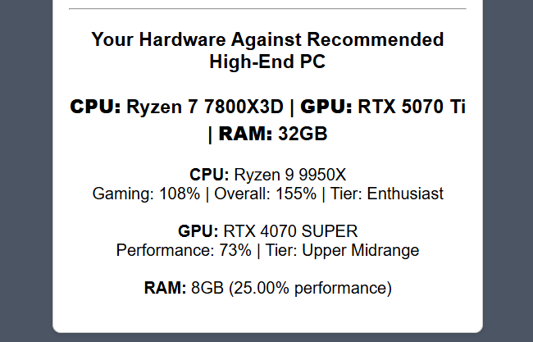
Main Features
📊System Analysis

Slide 15
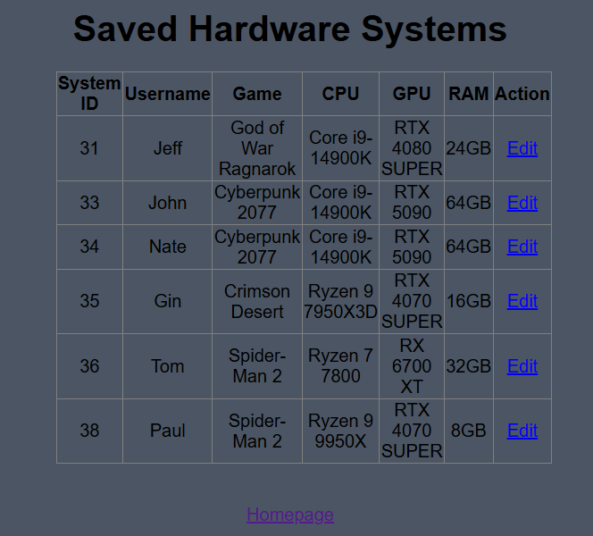
Main Features
💾Saved Systems

Slide 16
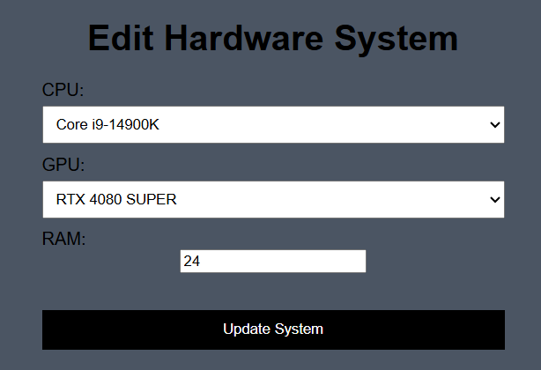
Main Features
✏️Edit Systems

Slide 17
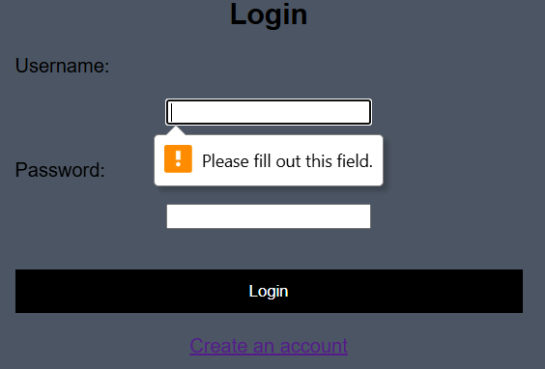
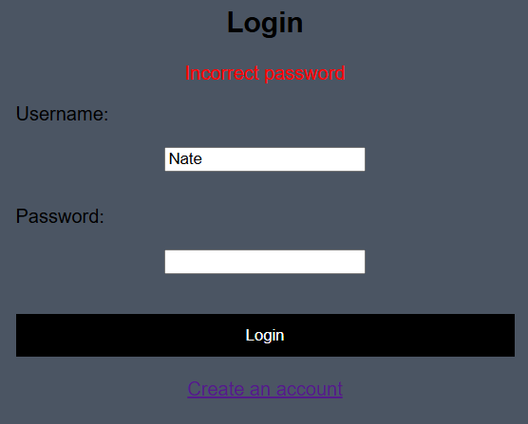
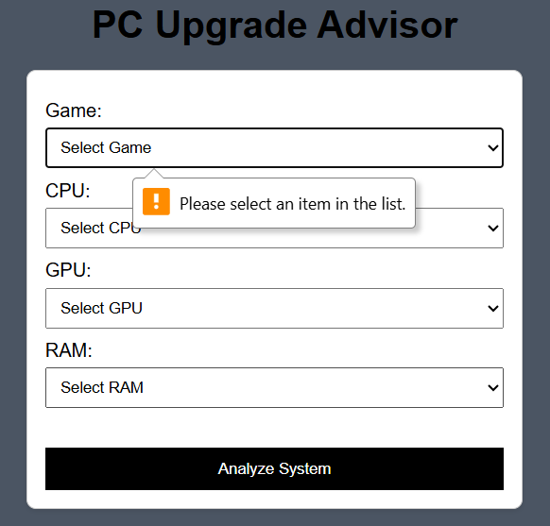
Security Features

Slide 18
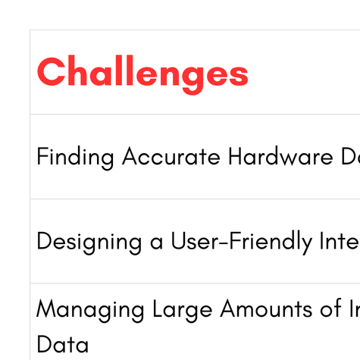
Challenges and Solutions

Slide 19

Live Demonstration

Slide 20


Future Improvements
FPS prediction system
AI-based recommendations
Mobile version of the application
Cloud storage integration
More games and hardware support
Real-time APIs and benchmark updates

Slide 21

Conclusion
Successfully developed a dynamic web application ✅
Combined benchmark data and game requirements ✅
Simplified gaming hardware analysis ✅
Provided upgrade recommendations ✅
Achieved the project objectives ✅

Slide 22

Questions?

